Slide 1
计算机组成
朱弘恣 教授
hongzi@sjtu.edu.cn

Slide 2

课程目标
熟悉现代电子计算机的组成和体系结构
除了设计原理，本课程将介绍两个典型处理器家族
  Intel x86 architecture: X86体系结构是最广泛应用于非嵌入式计算机系统的处理器家族，X86本质上是复杂指令集计算机（complex instruction set computer, CISC）
  ARM: ARM是最广泛应用于嵌入式系统的处理器家族，比如移动电话、传感器装备等等，其本质是精简指令集计算机（reduced instruction set computer, RISC)

Slide 3

课程计划
32 lessons/2 credits
  Lectures: 26 lessons,
  Experiments: 6 lessons (details TBA)
Course discussion group
  Resource: JBox平台：https://jbox.sjtu.edu.cn/l/5odWhf (密码:EI209)
  Canvas平台：https://oc.sjtu.edu.cn（个人JAccount登录）
  QQ group: 601697354 or scan the above 2D code
  Join TODAY and change your nickname shown in the group in the form of 学号_姓名
 | Content | Lectures | Experiments | Week
1 | Organization | 4 | 0 | W1
2 | x86 | 20 | 6 (from W6) | W2-W8
3 | Cortex | 2 | 0 | W8

Slide 4
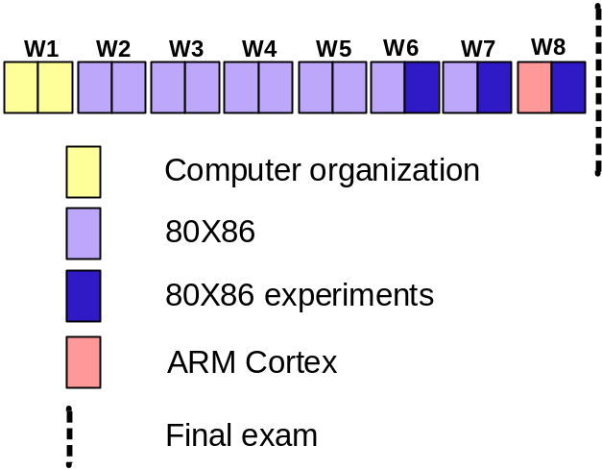
课程计划与成绩组成
 | Topic | Lecture | Experiments | Week
1 | Organization | 4 | 0 | W1
2 | x86 | 20 | 6 (from W6) | W2-W8
3 | Cortex | 2 | 0 | W8
Grading:
  Assignments, experiments, and class attendance: 30%
  Final exam: 70%

Slide 5
参考书
Computer organization
  Readings:
    Computer Organization and Architecture, 8rd edition, William Stallings. (PDF version is available, Chapter 1-Chapter 13)
80X86
  Readings:
    The 80x86 IBM PC and Compatible Computers, 4th edition, Muhammad Ali Mazidi,..(PDF version is available)
      Chap.0-Chap.3, Chap.6, Chap.9.1, Chap. 10, Chap.11.1-Chap.11.4, Chap. 12.3-Chap.12.4, Chap. 13, Chap.14.1-Chap.14.4
    微型计算机原理与接口技术（第四版，电子版）
  Experiment environments:
    Proteus simulation software
ARM Cortex-M4
  Readings:
    The Definitive Guide to ARM Cortex-M3 and Cortex-M4 Processors Third Edition, Joseph Yiu. (PDF version is available)

Slide 6
联系方式
Email
  hongzi@sjtu.edu.cn
Office & Lab
  Rm 129, No.3 SEIEE Building
Website
  http://lion.sjtu.edu.cn
Notes:
要点：

